Slide 1
期中作業
K060A104
黃彥睿

Slide 2
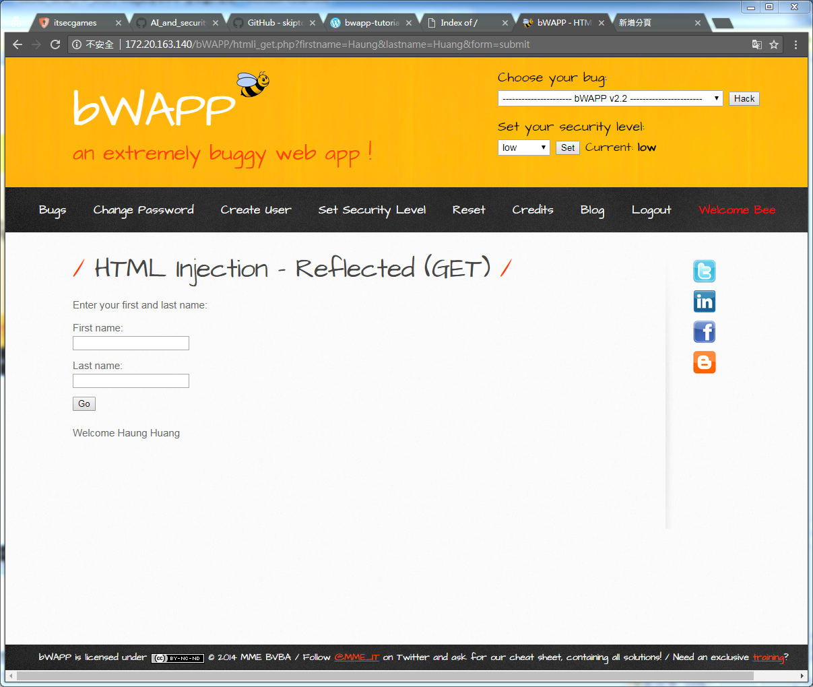
http://172.20.163.140/bWAPP/htmli_get.php?firstname=Haung&lastname=Huang&form=submit

Slide 3
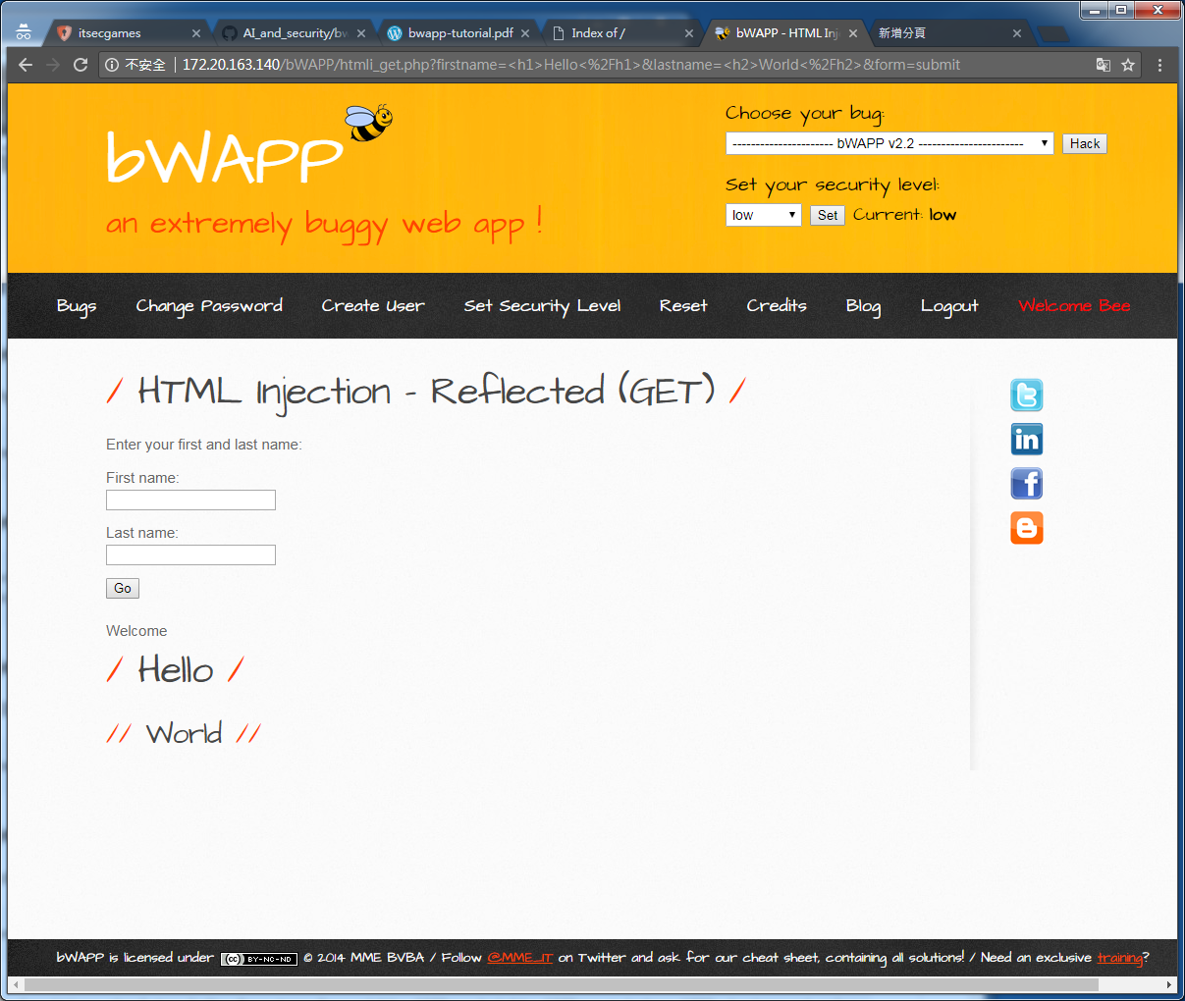
http://172.20.163.140/bWAPP/htmli_get.php?firstname=%3Ch1%3EHello%3C%2Fh1%3E&lastname=%3Ch2%3EWorld%3C%2Fh2%3E&form=submit

Slide 4
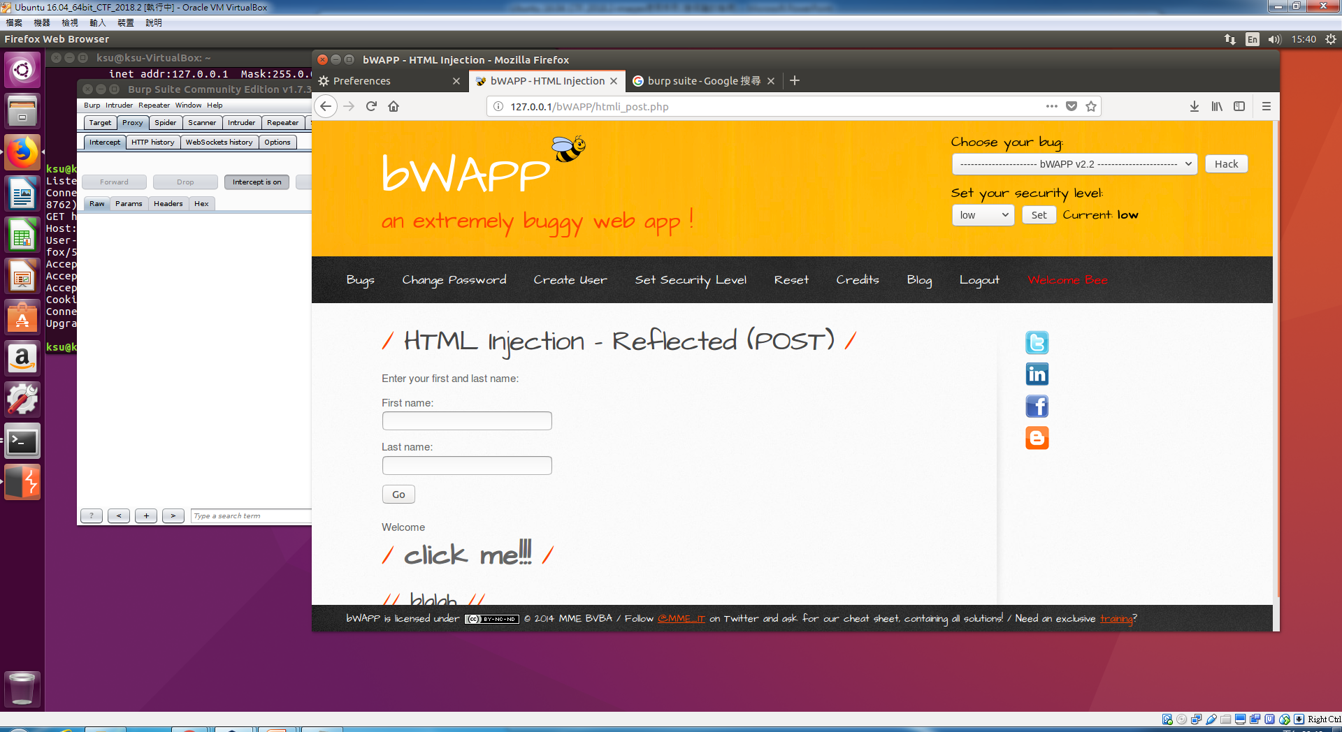
firstname=<h1><a href="http://www.google.com">click me!!!</a></h1>&lastname=<h2>blalah</h2>&form=submit

Slide 5
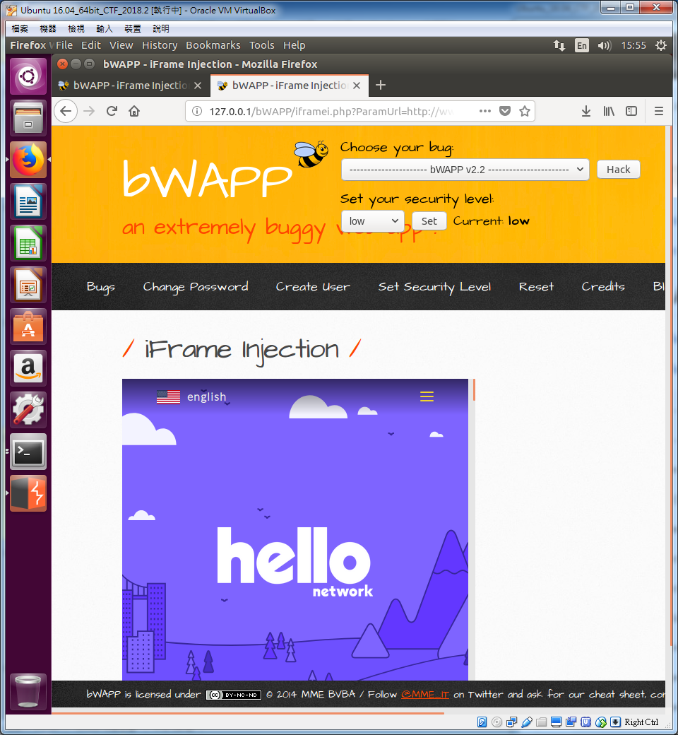
http://127.0.0.1/bWAPP/iframei.php?ParamUrl=http://www.hello.com/&ParamWidth=500 &ParamHeight=500

Slide 6
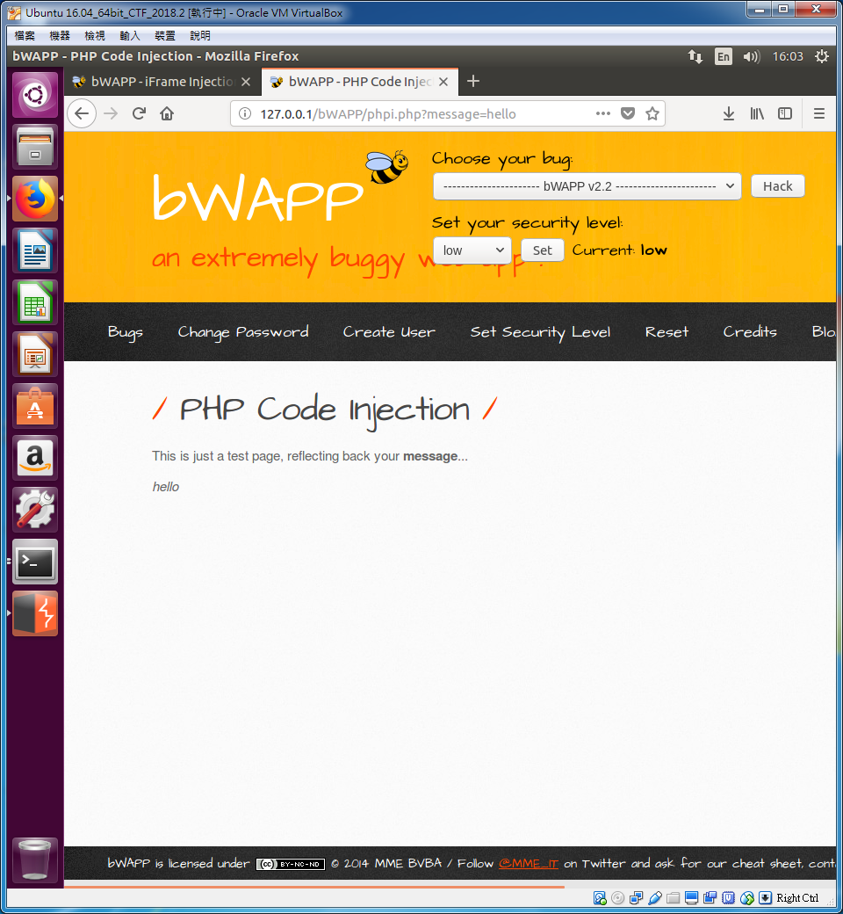
PHP Code Injection

Slide 7
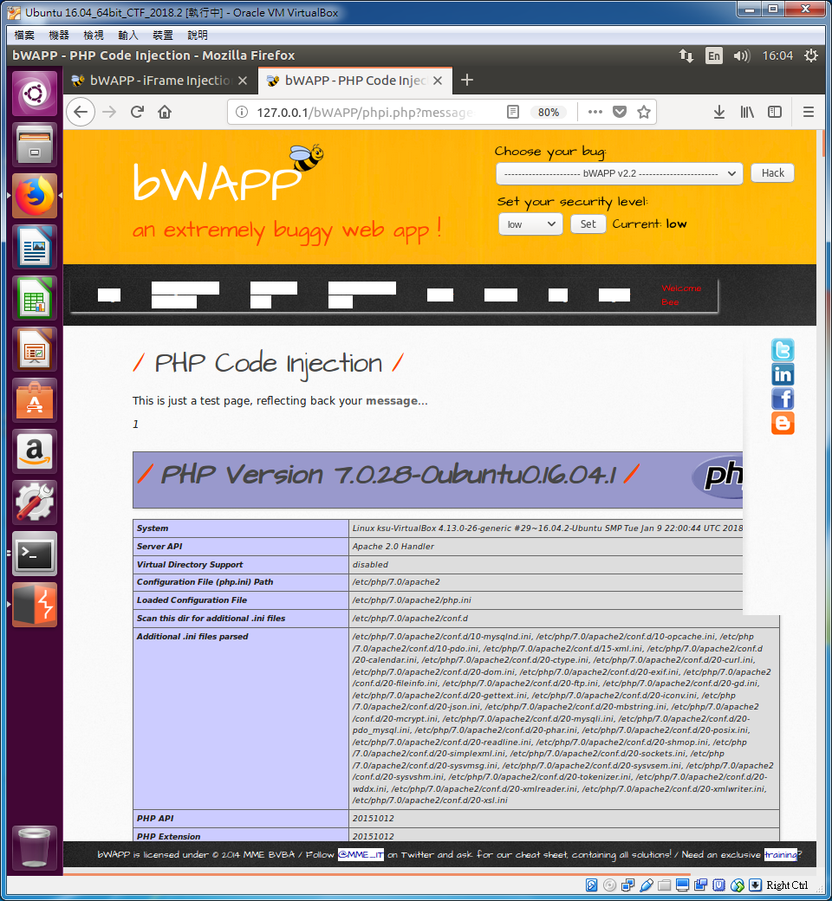
PHP Code Injection

Slide 8
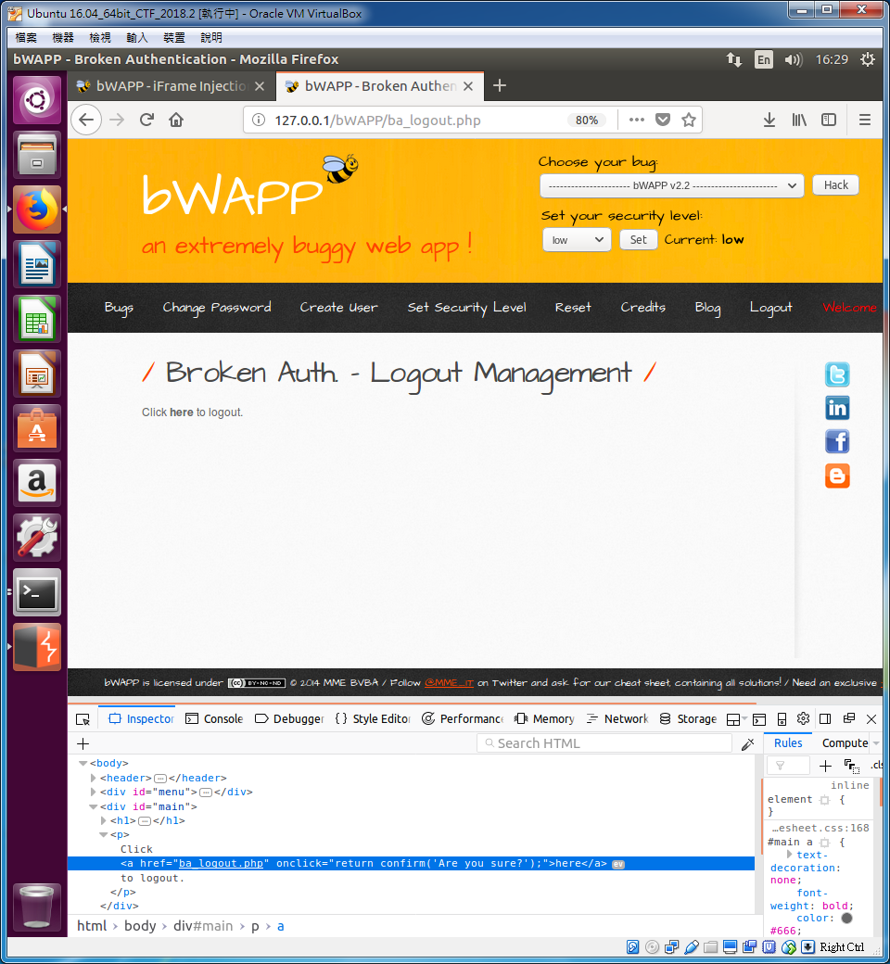
BA - Logout Management

Slide 9
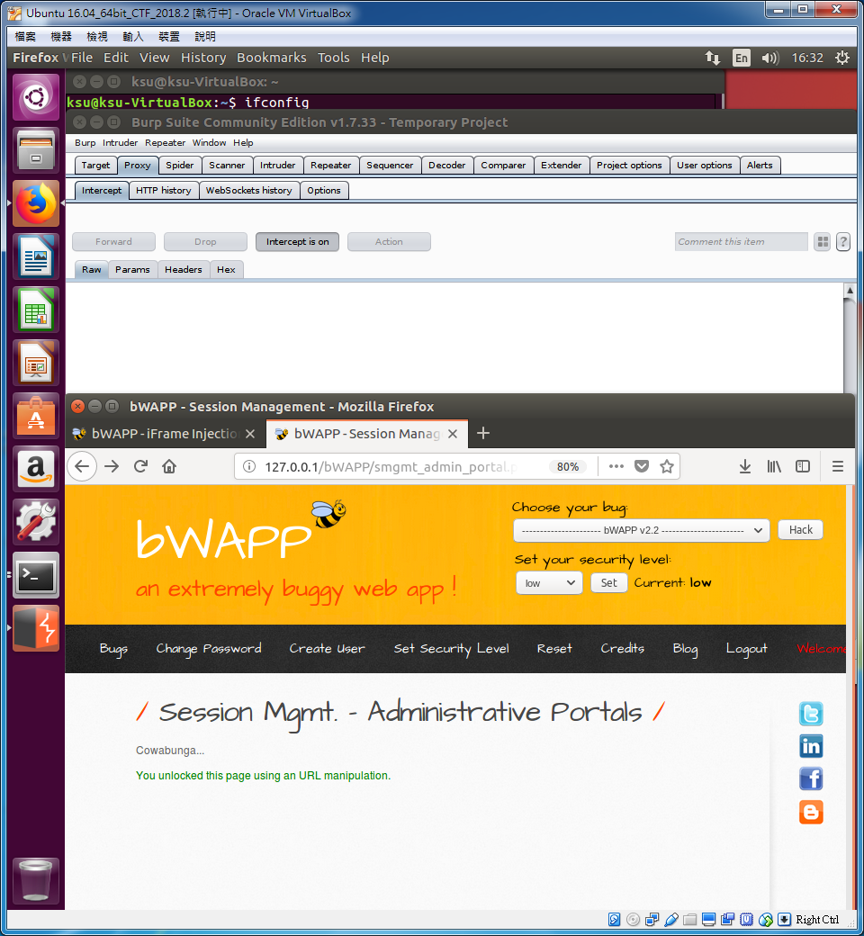
BA - Session Management

Slide 10
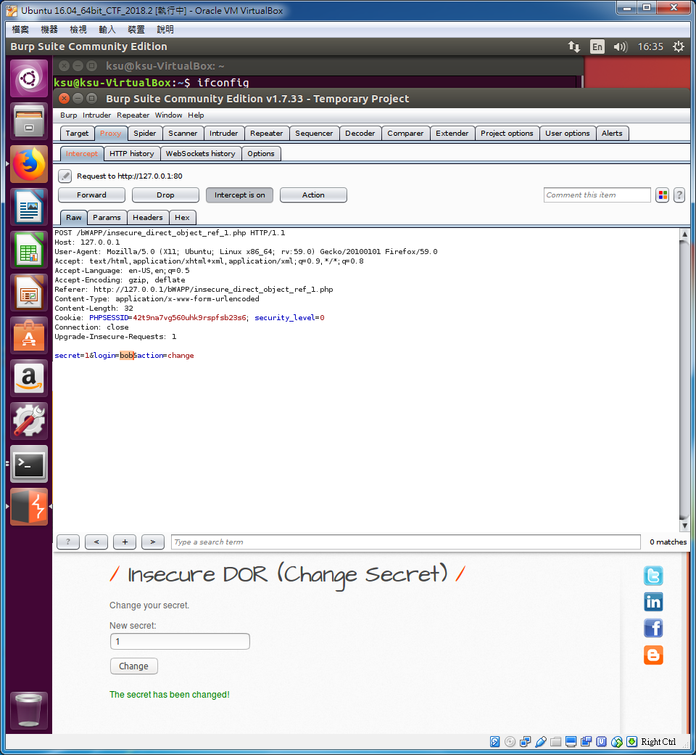
Insecure Direct Object Reference (Change Secret)

Slide 11
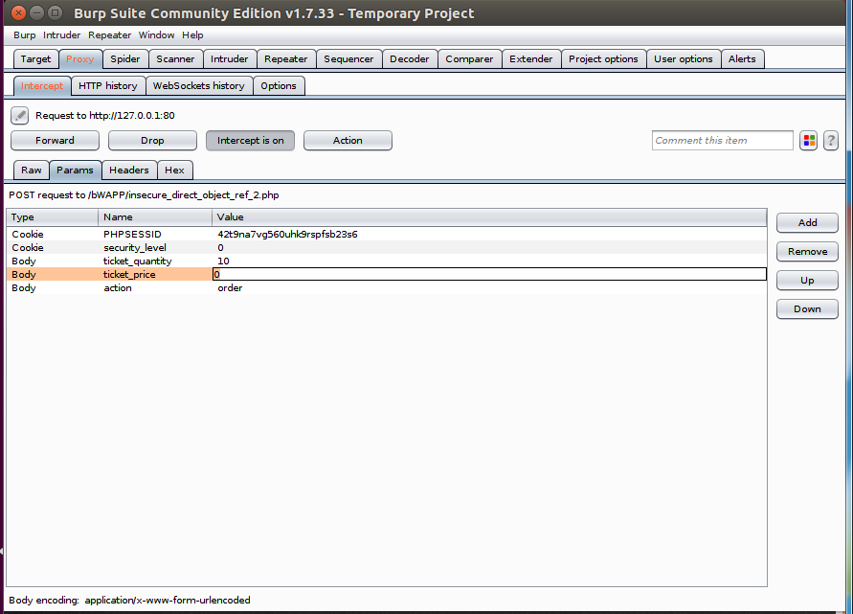
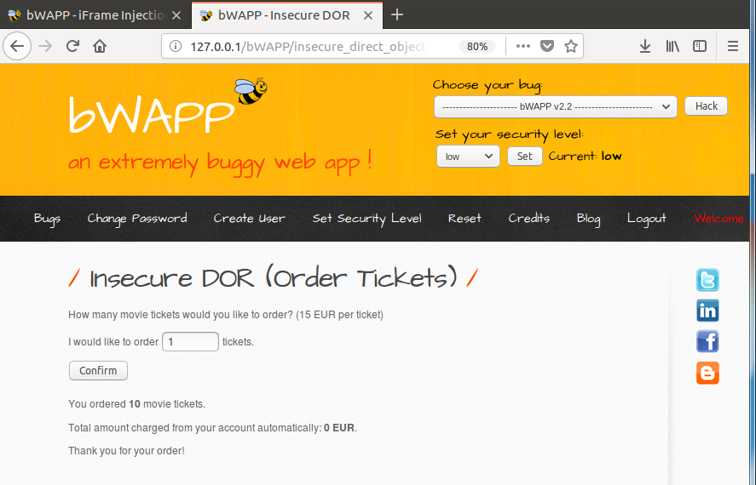
Insecure Direct Object Reference (Order Ticket)

Slide 12
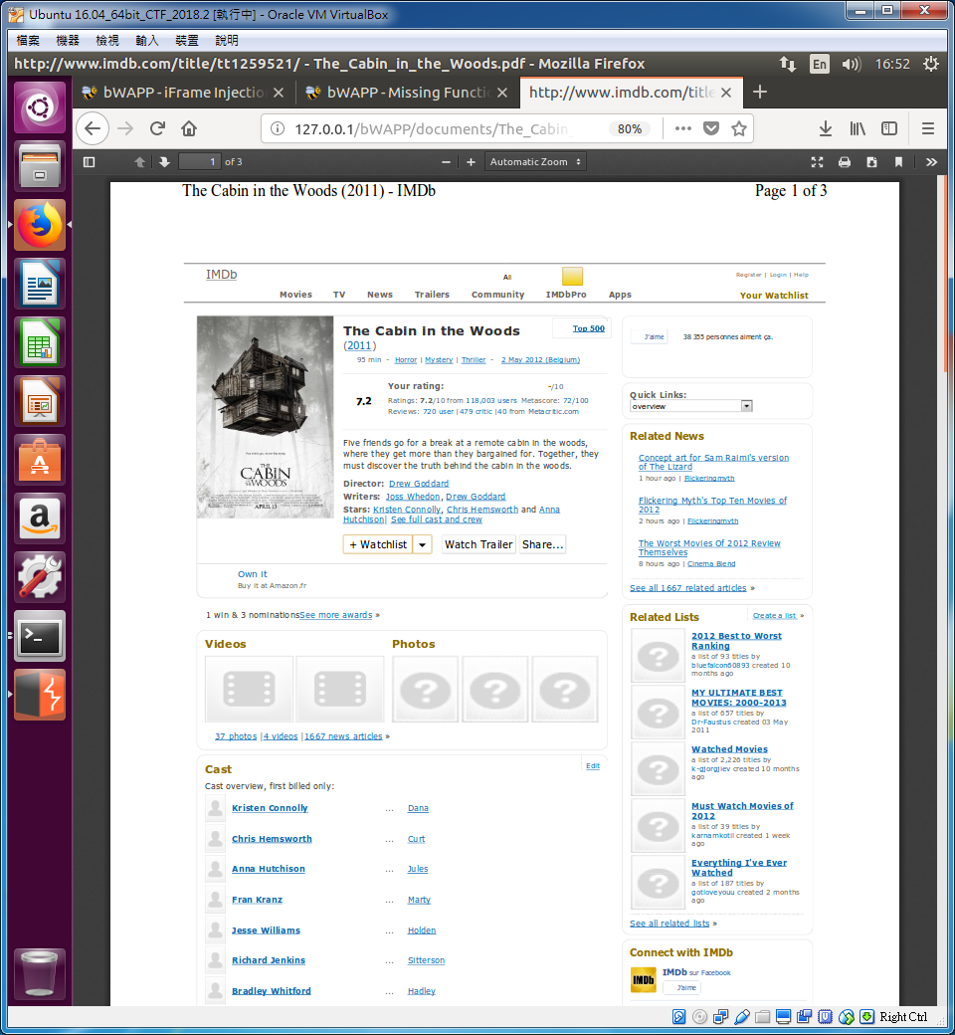
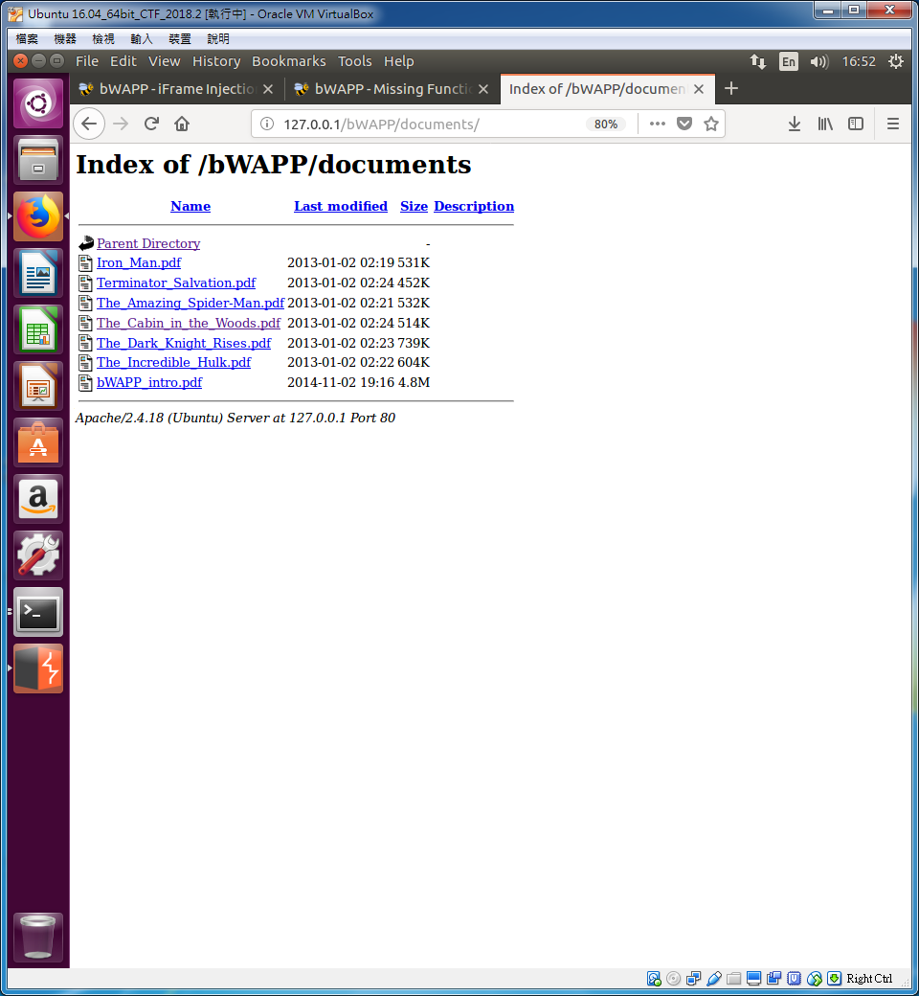
Directory Traversal (Directories)

